Slide 1
DSC 530 Final Project
Graduate Admissions Data
Allyson Busch - DSC 530

Slide 2
Data Set on Graduate Admissions
Creation
Characteristics
Our Question
M.S. Acharya, A. Armaan, A.S. Antony : A Comparison of Regression Models for Prediction of Graduate Admissions, IEEE International Conference on Computational Intelligence in Data Science 2019
9 variables
400 separate entries
Includes 1-5 ranked variables
Includes binary variable
Includes ID tag variable
What application variable best predicts whether a prospective graduate student will be accepted to a program?

Slide 3
Hypothesis
If a prospective students wants to be admitted to a graduate school program, then they should focus on raising their GRE score because this has the highest effect on admission outcome.

Slide 4
Variables Used

Slide 5
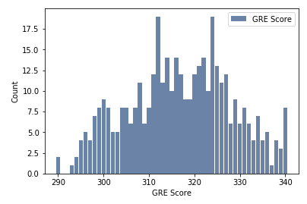
GRE Score
Meaning: Graduate Record Examination (admissions test) score, out of 340
Mean: 316.81
Mode: 312, 32
Spread: 131.32
Tails: 2-tailed
Variable 1

Slide 6
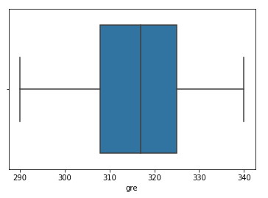
GRE Score
Explanation: There were no outliers in the GPA variable. The maximum GRE score is a combined 340 and there were no numbers above that. Additionally, there were no GRE scores under 260, which is the minimum score possible.
Outliers

Slide 7
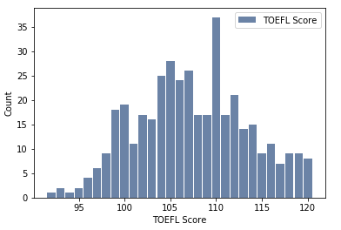
TOEFL Score
Meaning: Test of English as a Foreign Language score, out of 120
Mean: 107.41
Mode: 110
Spread: 36.75
Tails: 2-tailed
Variable 2

Slide 8
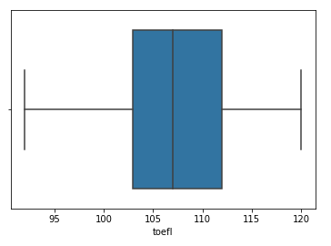
TOEFL Score
Explanation: There were no outliers in the TOEFL variable. The maximum score possible is 120, which is the maximum score we received. The minimum score is a 0, and the dataset didn’t include any numbers below 0.
Outliers

Slide 9
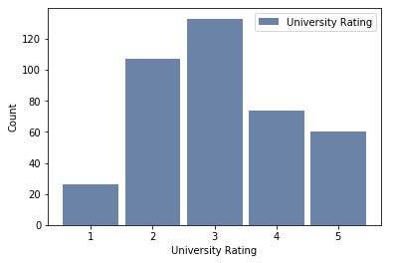
University Rating
Meaning: Out of 5
Mean: 3.09
Mode: 3
Spread: 1.3
Tails: 2-tailed
Variable 3

Slide 10
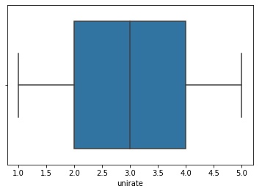
University Rating
Explanation: There were no outliers in the University Rating variable. The scale was 1-5, and there were no entries above or below that number.
Outliers

Slide 11
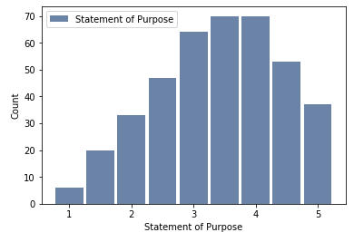
SOP
Meaning: Statement of Purpose, strength rated out of 5
Mean: 3.4
Mode: 3.5, 4
Spread: 1.01
Tails: 2-tailed
Variable 4

Slide 12
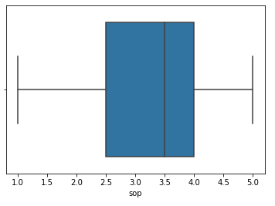
SOP
Explanation: There were no outliers in the Statement of Purpose variable. The scale was 1-5, and all entries were between those numbers.
Outliers

Slide 13
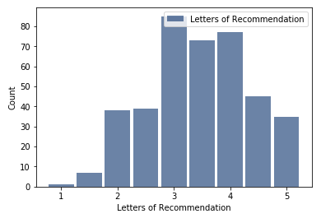
LOR
Meaning: Letter of Recommendation, strength out of 5
Mean: 3.45
Mode: 3
Spread: 0.81
Tails: 2-tailed
Variable 5

Slide 14
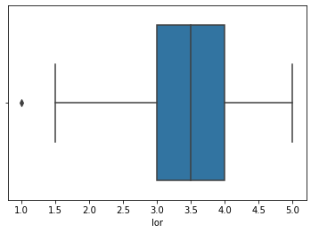
LOR
Explanation: There was an outlier of 1 in the Letters of Recommendation variable. I believe it should be kept in as it is in the acceptable range and was correctly input. A low Letter of Recommendation rating might mean their professors wrote a weak letter.
Outliers

Slide 15
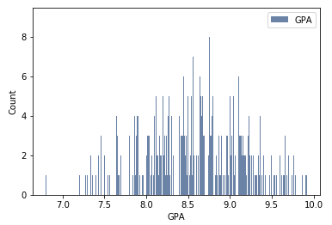
CGPA
Meaning: Undergraduate GPA, utilizing a 10 point scale
Mean: 8.6
Mode: 8
Spread: 0.35
Tails: 2-tailed
Variable 6

Slide 16
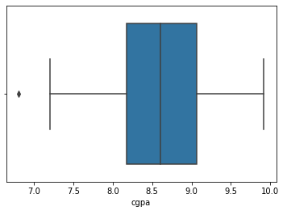
CGPA
Explanation: There was an outlier of 6.8 in the GPA variable. I believe we should keep the outlier, as it is still in the acceptable GPA range. The GPA is from 1-10 because it is an international GPA, as this is a dataset focusing on Indian students. This could easily be translated to a 4.0 scale for an American hoping to utilize the predictions.
Outliers

Slide 17
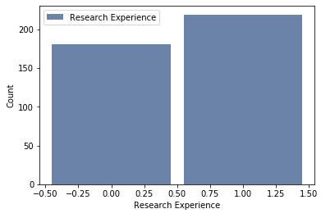
Research
Meaning: Research Experience, binomial variable with 0 = None, 1 = Any
Mean: 0.55
Mode: 1
Spread: 0.25
Tails: N/A
Variable 7

Slide 18
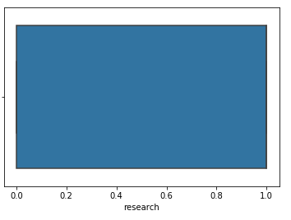
Research
Explanation: There were no outliers in the Research Experience Variable. The variable was binomial and all entries were either 0 or 1.
Outliers

Slide 19
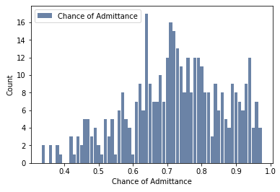
Chance of Admit
Meaning: Probability of Admittance, from 0 to 1
Mean: 0.72
Mode: 0.64
Spread: 0.02
Tails: 2-tailed
Variable 8

Slide 20
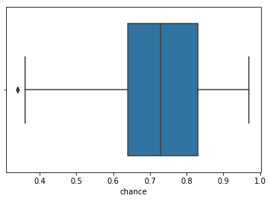
Chance of Admit
Explanation: There was a outlier of 0.34 in the Chance of Admittance variable. I believe it should still be included, as it is still in the range of 0 to 1, and represents an applicant with a low chance of admittance.
Outliers

Slide 21
Calculations

Slide 22
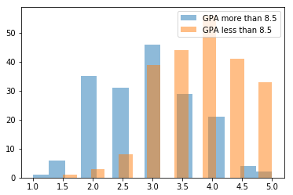
PMF
Students with higher GPAs (split at roughly the median), tend to receive higher Letter of Recommendation scores. This means that professors are writing better Letters of Recommendation to students with higher grades (both in their courses, and in their program).
Letter of Recommendation Rating based on GPA

Slide 23
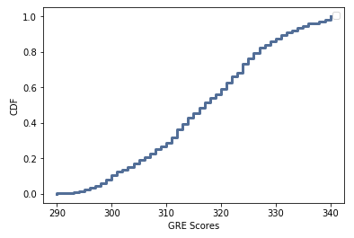

CDF
GRE Scores

Slide 24
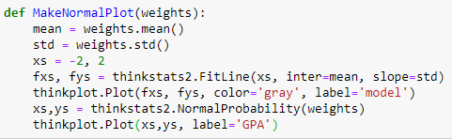
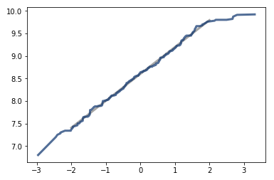
Analytical Distribution
GPA
Model roughly fits the data

Slide 25
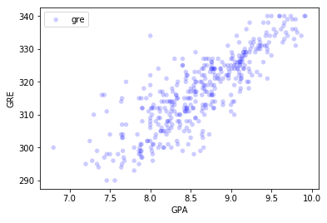
Scatterplot 1
Positive Correlation: 0.83
Fairly high chance of causation
Students with higher GPAs will have better study habits and better test taking skills, which will result in higher GRE scores
GPA & GRE Scores

Slide 26
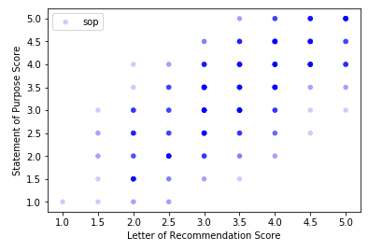
Scatterplot 2
Positive Correlation: 0.73
Low chance of causation
Students with a strong statement of purpose may have a strong desire to attend a graduate program. You could argue this desire would drive them to do better in coursework now, which would result in higher letters of recommendation, but there seems to be an underlying causation beyond those.
Statement of Purpose Score & Letter of Recommendation Score

Slide 27
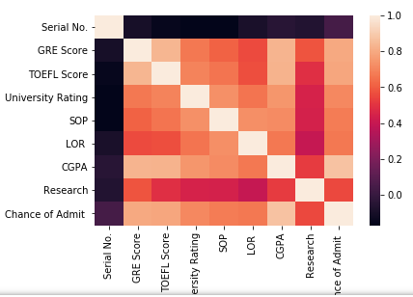
Correlation
The variables with the highest correlations are GPA and GRE scores, GPA and TOEFL scores, GPA and Chance of Admittance, GRE scores and Chance of Admittance, & TOEFL scores and Chance of Admittance.
The variables with the lowest correlations are Research with the following: Letters of Recommendation, Statement of Purpose, University Rating, and TOEFL Scores.

Slide 28
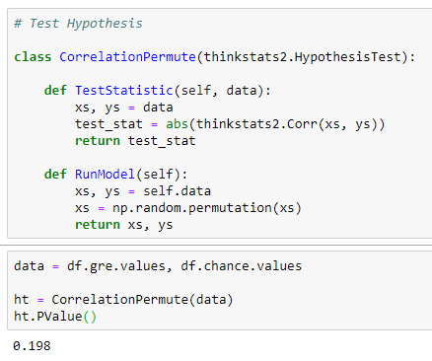
Hypothesis Test

Slide 29
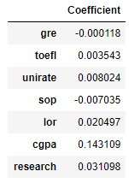
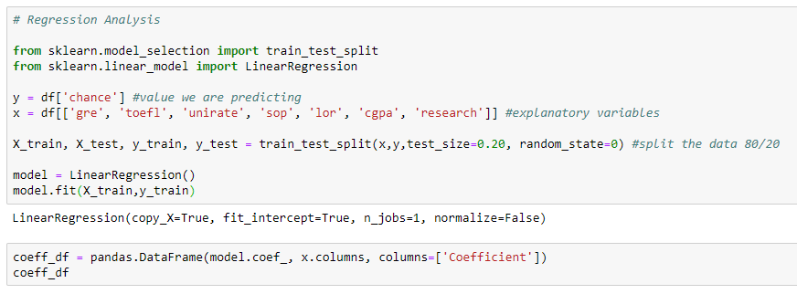
Regression Analysis

